Slide 1


PROJECT PRESENTATION
TRACKING SPACE OBJECTS: ORBITAL ANALYSIS AND COLLISION RISK VISUALIZATION
GEOG-582 GIS Programming with Python
Name : Suamnth Paila
RedID: 132639608

Slide 2

INTRODUCTION
The rapid increase in space activity has led to a growing challenge: the accumulation of space debris. From inactive satellites to fragments of collisions, these objects pose severe risks to operational satellites and future missions. With tens of thousands of tracked objects and countless smaller fragments, the potential for collisions in Earth's orbit is escalating.
This project analyzes and visualizes the orbits of space debris, leveraging real-world data to calculate orbital paths, classify trajectories, and identify high-density regions in Low Earth Orbit (LEO), Medium Earth Orbit (MEO), and Geostationary Orbit (GEO). Using advanced modeling and visualization tools, we provide insights into debris dynamics, distribution, and potential risk areas.
The results support collision risk assessments, helping to identify critical congestion zones and offering visual clarity on space traffic. By bridging data analysis with actionable insights, this project contributes to efforts in mitigating risks and ensuring the sustainability of Earth's orbital environment.

Slide 3
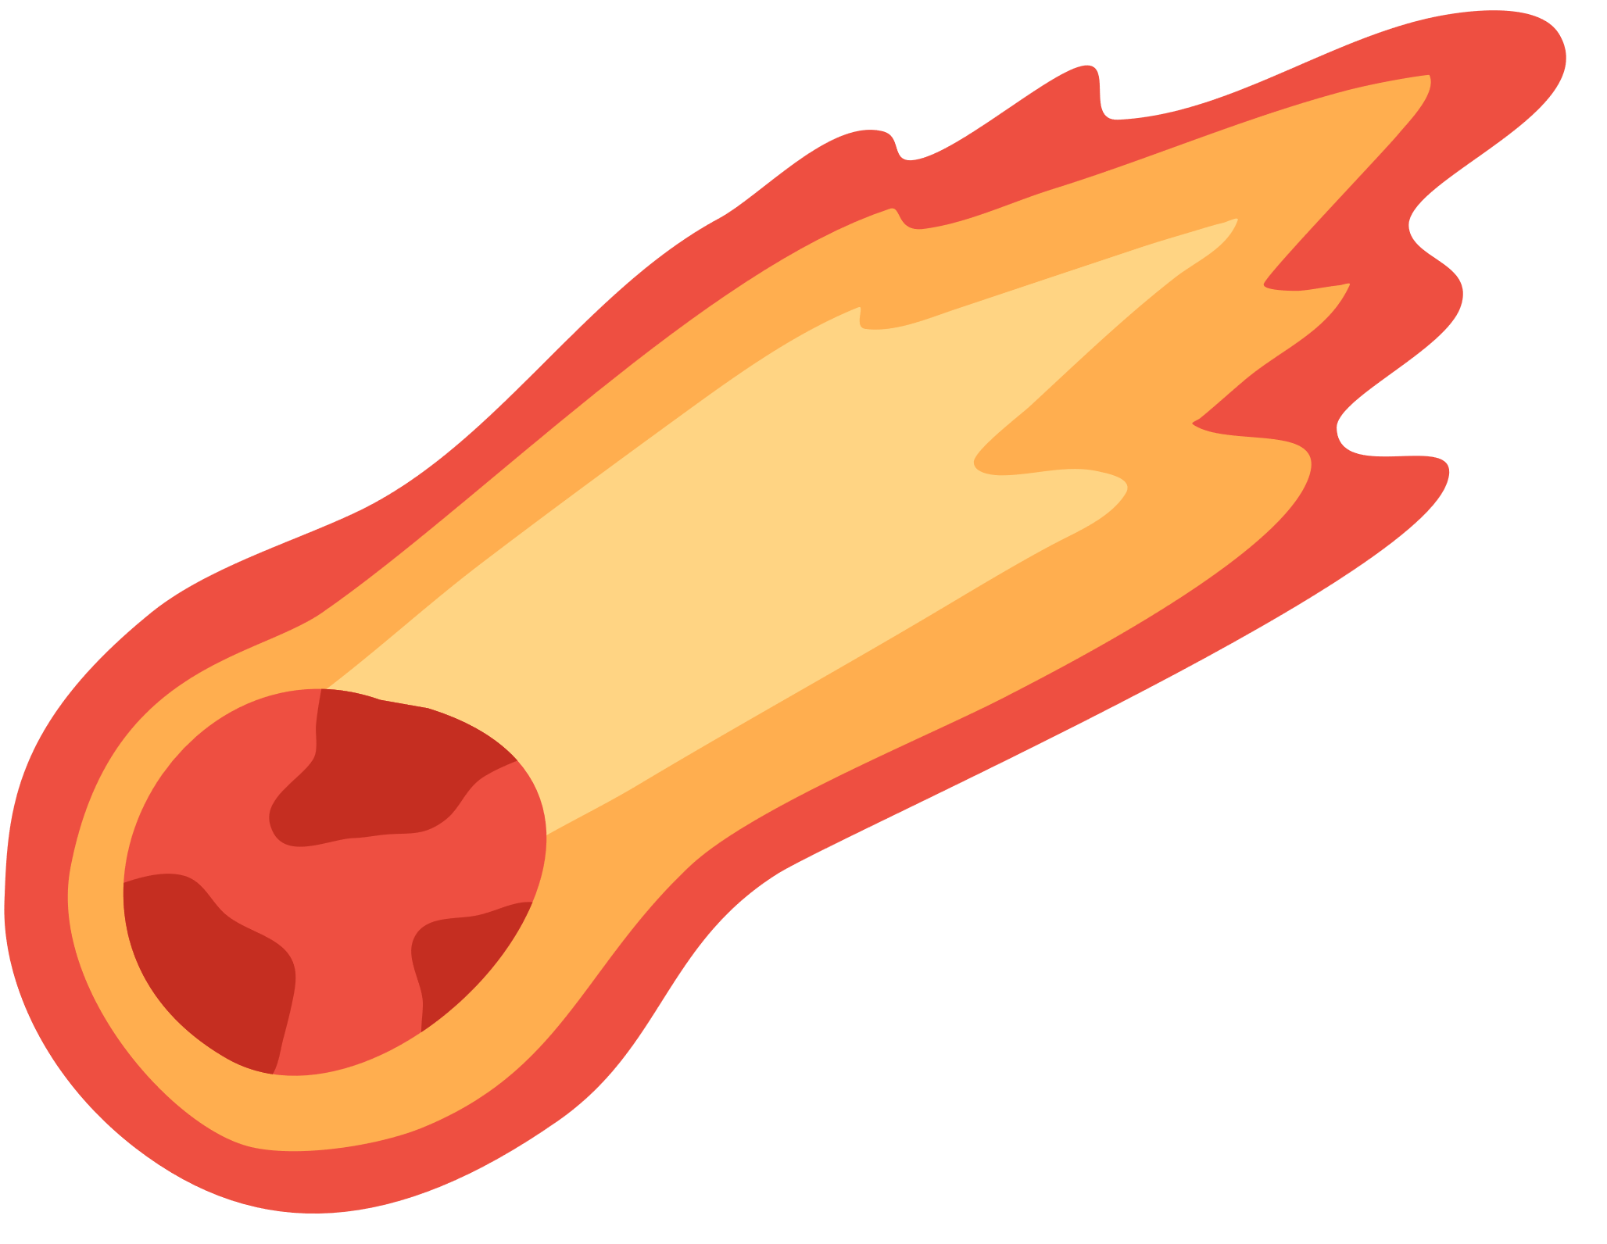



PROJECT OBJECTIVES
01.
Calculating Orbital Paths: Methodology and Visualization
02.
Density Analysis and Orbital Classification: Understanding Space Debris Distribution
03.
Collision Detection and Visualization
PAGE 02

Slide 4
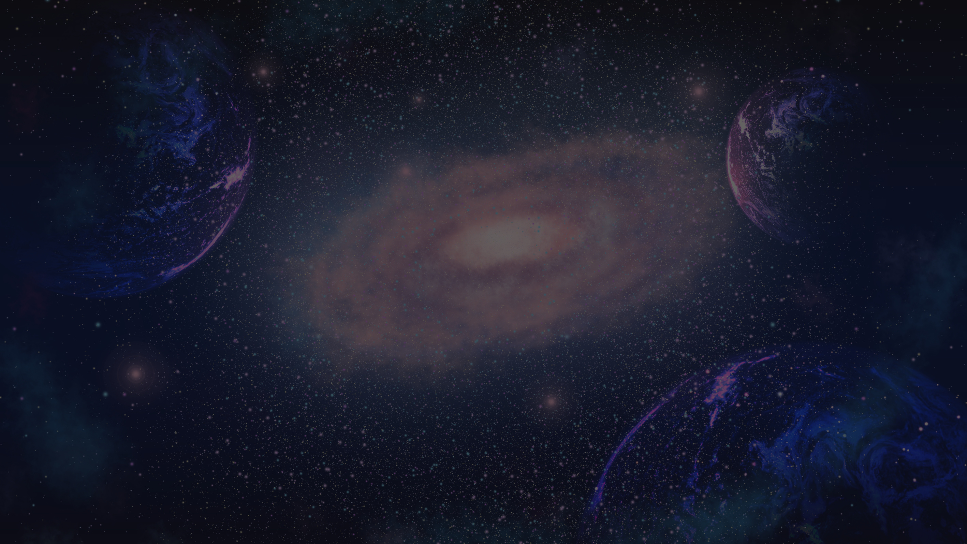
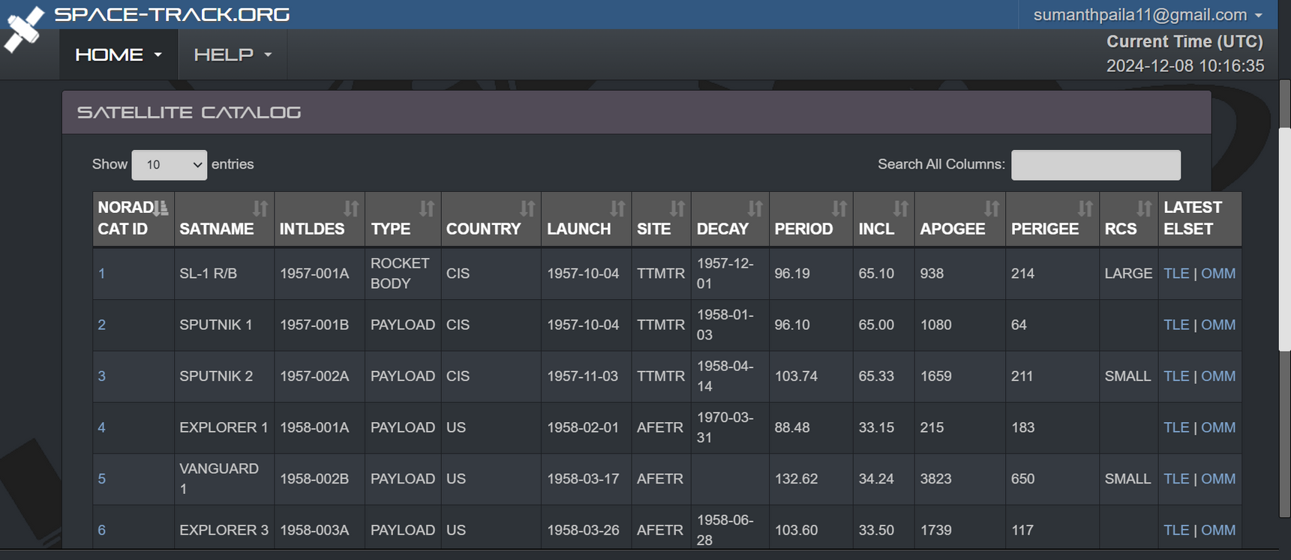
DATA
HTTPS://WWW.SPACE-TRACK.ORG/#CATALOG
PROJECT PRESENTATION
PAGE 03

Slide 5
LIBRARIES USED
pandas: For data manipulation, loading datasets, handling missing values, and preprocessing.
numpy: For numerical computations like trigonometric functions, array operations, and orbital path calculations.
pyvista: For 3D visualization of Earth and orbital trajectories with detailed rendering and environmental effects.
scipy: Used scipy.spatial.distance.cdist for efficient computation of pairwise distances between orbital objects.
plotly: For interactive 3D scatter plots and network visualizations of collision risks and object distributions.
networkx: For creating and visualizing the collision network graph with nodes and edges representing objects and risks.
seaborn: For density analysis and heatmap visualizations to identify congestion in orbital layers.
matplotlib: For 2D plots and supporting density visualizations with clear annotations and grids.
This list covers the core libraries and their specific purposes in the project.
H

Slide 6
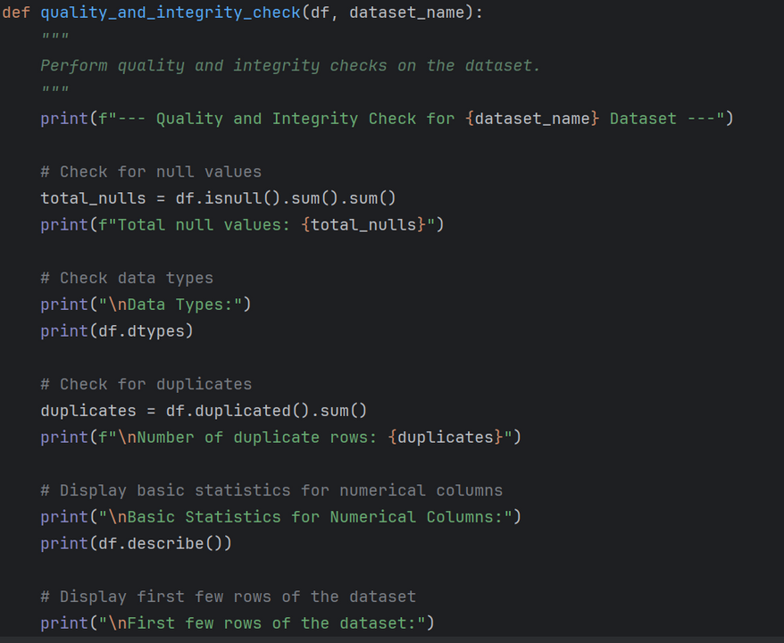
DATA PREPROCESSING
DATA QUALITY AND INTEGRITY CHECKS:
NULL VALUES:
CHECK THE TOTAL NUMBER OF MISSING VALUES IN THE DATASET.
DUPLICATE ROWS:
IDENTIFY AND COUNT DUPLICATE ROWS FOR POTENTIAL REMOVAL.
DATA TYPE VALIDATION:
CONFIRM THAT EACH COLUMN HAS AN APPROPRIATE DATA TYPE.
BASIC STATISTICS:
INSPECT DESCRIPTIVE STATISTICS FOR NUMERICAL COLUMNS TO VERIFY DATA DISTRIBUTION.
PROJECT PRESENTATION
PAGE 03

Slide 7
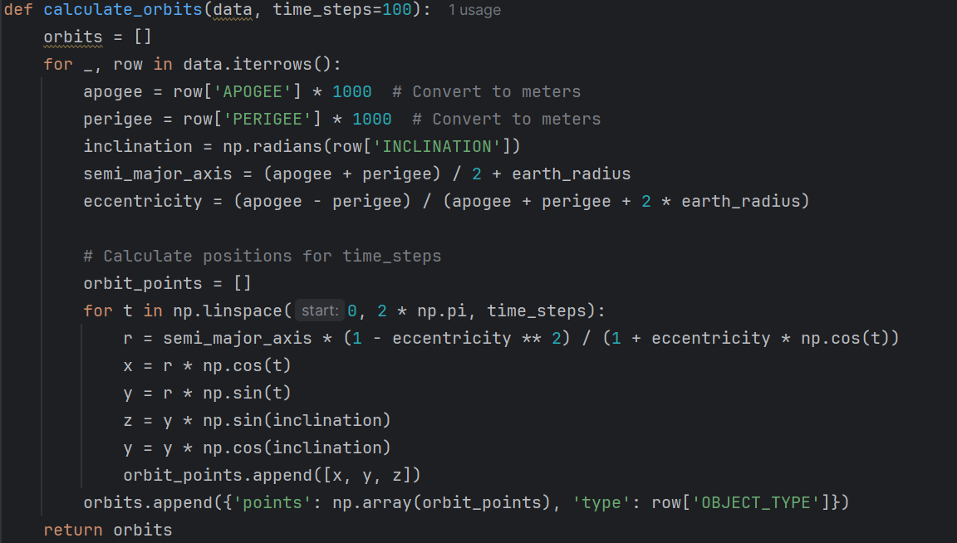
CALCULATING ORBITAL PATHS: METHODOLOGY AND VISUALIZATION
APOGEE AND PERIGEE:
The farthest and nearest points of the object's orbit from Earth.
Converted from kilometers to meters for consistency.
Inclination:
Angle of the orbit relative to Earth’s equator (in degrees).
Converted to radians for trigonometric calculations using np.radians().
PROJECT PRESENTATION
PAGE 03

Slide 8
CALCULATING ORBITAL PATHS: METHODOLOGY AND VISUALIZATION
SEMI-MAJOR AXIS:
AVERAGE DISTANCe from Earth’s center to the orbit’s farthest point.
Calculated as:
SMA = (APOGEE + PERIGREE)/2 + EARTH RADIUS
Eccentricity:
DEFInes the orbit's shape (circular, elliptical, etc.).
Calculated as:
ECCENTRICITY = (APOGEE - PERIGREE)/ (APOGEE + PERIGREE+2 * EARTH RADIUS)
TIME-STEP CALCULATION:
THE ORBIT IS DIVIDED INTO TIME_STEPS (E.G., 100 POINTS) EVENLY SPACED OVER A FULL ROTATION (0 TO 2PI).
CALCULATING RADIAL DISTANCE FOR EACH TIME STEP
RADIAL DISTANCE = SMA * (1 - ECCENTRICITY^2)/ 1 + ECCENTRICITY * COS(T)
PROJECT PRESENTATION
PAGE 03

Slide 9

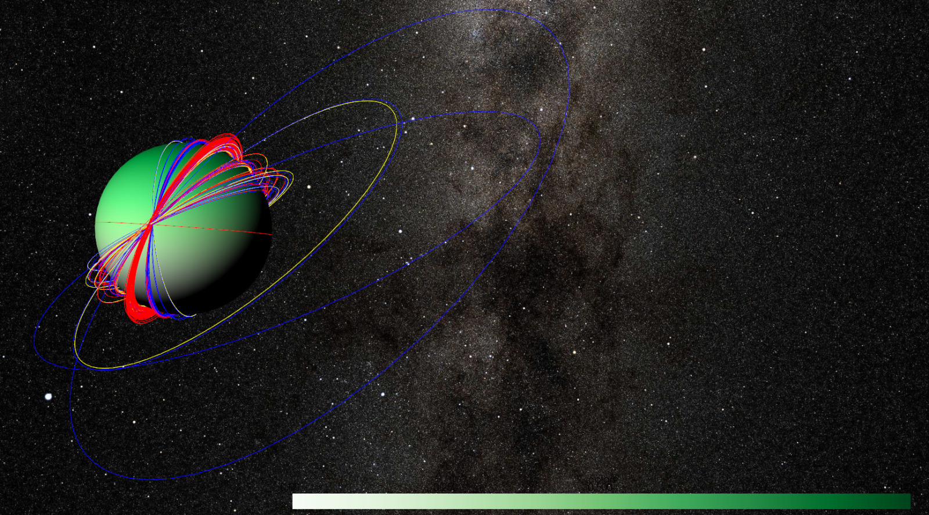

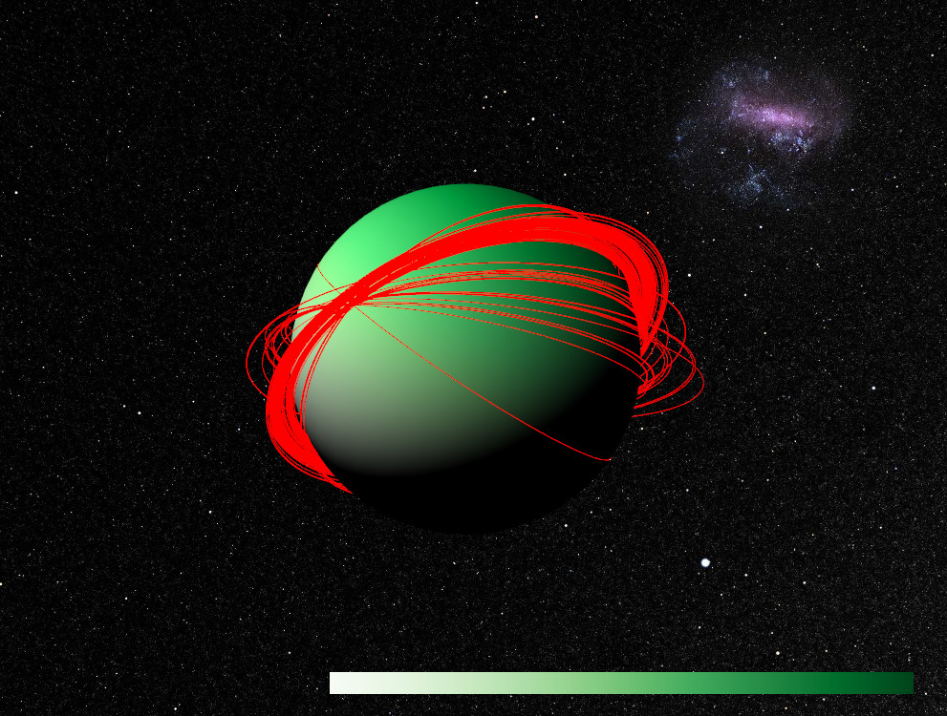

Slide 10
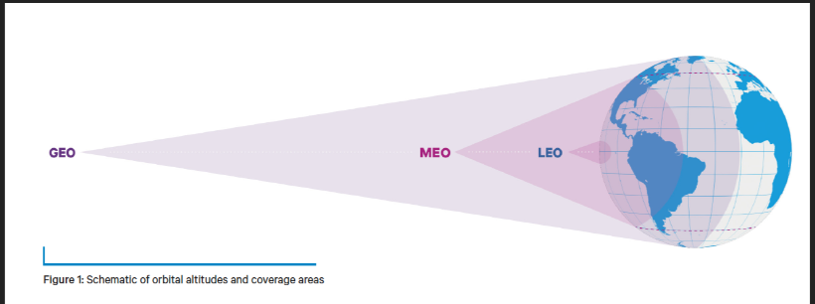
DENSITY ANALYSIS AND ORBITAL CLASSIFICATION: UNDERSTANDING SPACE DEBRIS DISTRIBUTION
CLASSIFIED SPACE OBJECTS INTO THREE ORBITAL categories (LEO, MEO, GEO) based on their apogee values.
Visualized the spatial distribution of objects in each orbital class using 3D plots.
Conducted density analysis in LEO using Kernel Density Estimation (KDE) to identify high-congestion areas.
Identified high-inclination, high-density regions in LEO that pose significant collision risks.
HIGHLIGHted specific debris objects in critical regions for targeted mitigation strategies.
PAGE 03

Slide 11
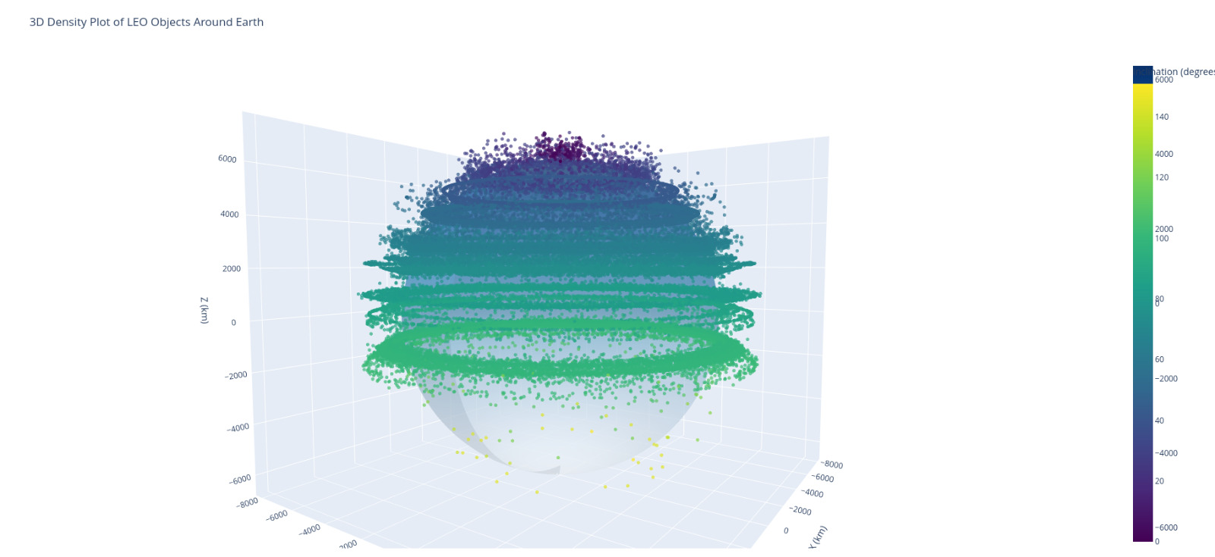
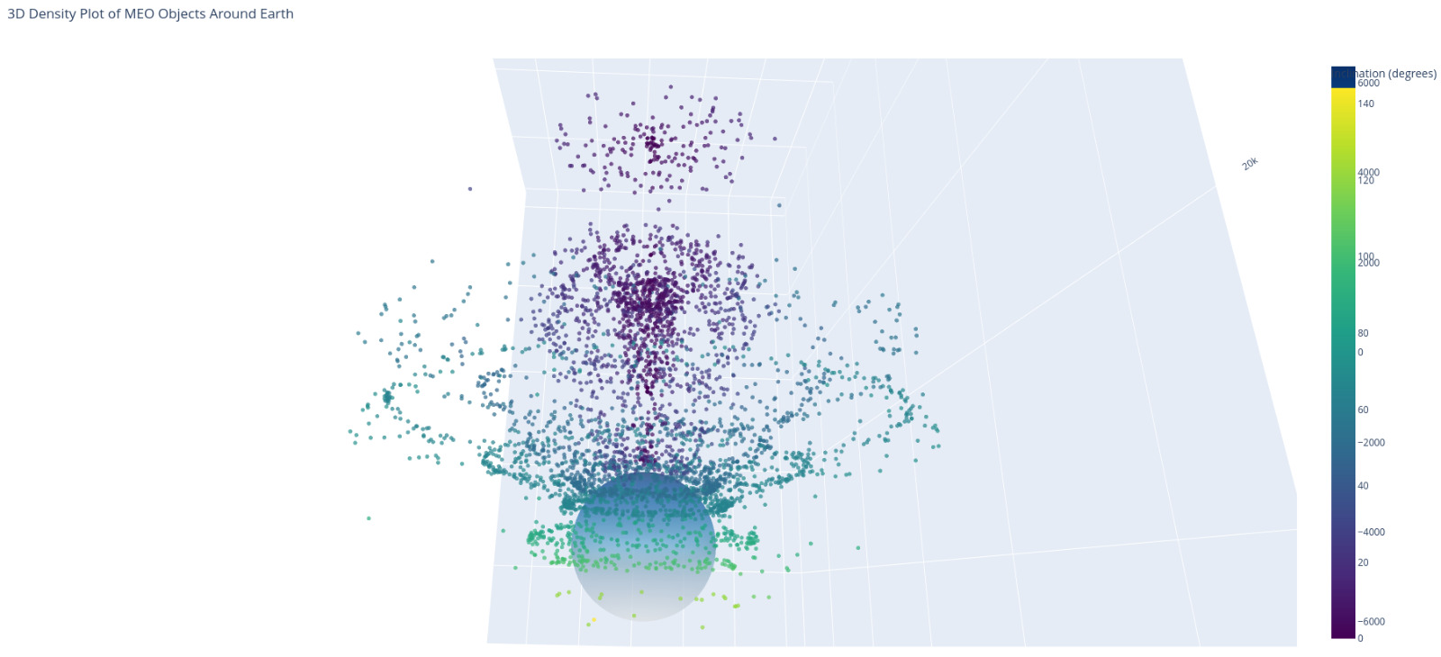


PROJECT PRESENTATION
LEO MEO
PAGE 04

Slide 12
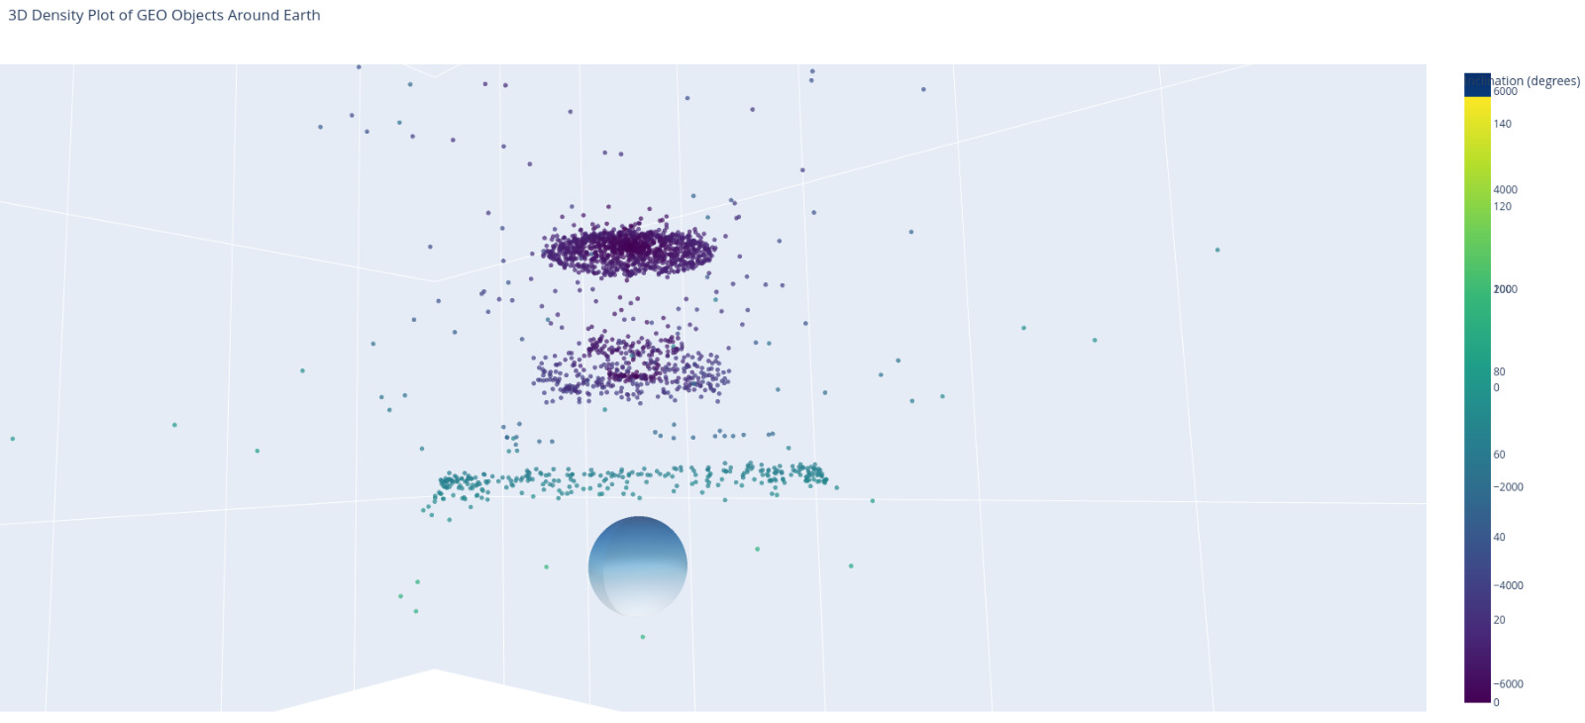
PROJECT PRESENTATION
GEO
PAGE 04

Slide 13
COLLISION DETECTION AND VISUALIZATION
COLLISION DETECTION:
Calculated pairwise distances between objects using apogee, perigee, and inclination.
Identified pairs with distances below a defined threshold (e.g., 3 km), indicating collision risks.
3D Visualization of Collisions:
Used Plotly to create an interactive 3D scatter plot:
Displayed objects color-coded by type (e.g., payload, debris).
Highlighted collision pairs with connecting red lines.
Collision Network Graph:
Built an interactive network graph with nodes representing objects and edges indicating potential collisions.
Used node colors to represent object types and edge weights for collision risk severity.
Insights:
Detected high-risk collision pairs with precise distances.
Provided interactive visualizations to explore collision scenarios and their spatial relationships.

Slide 14

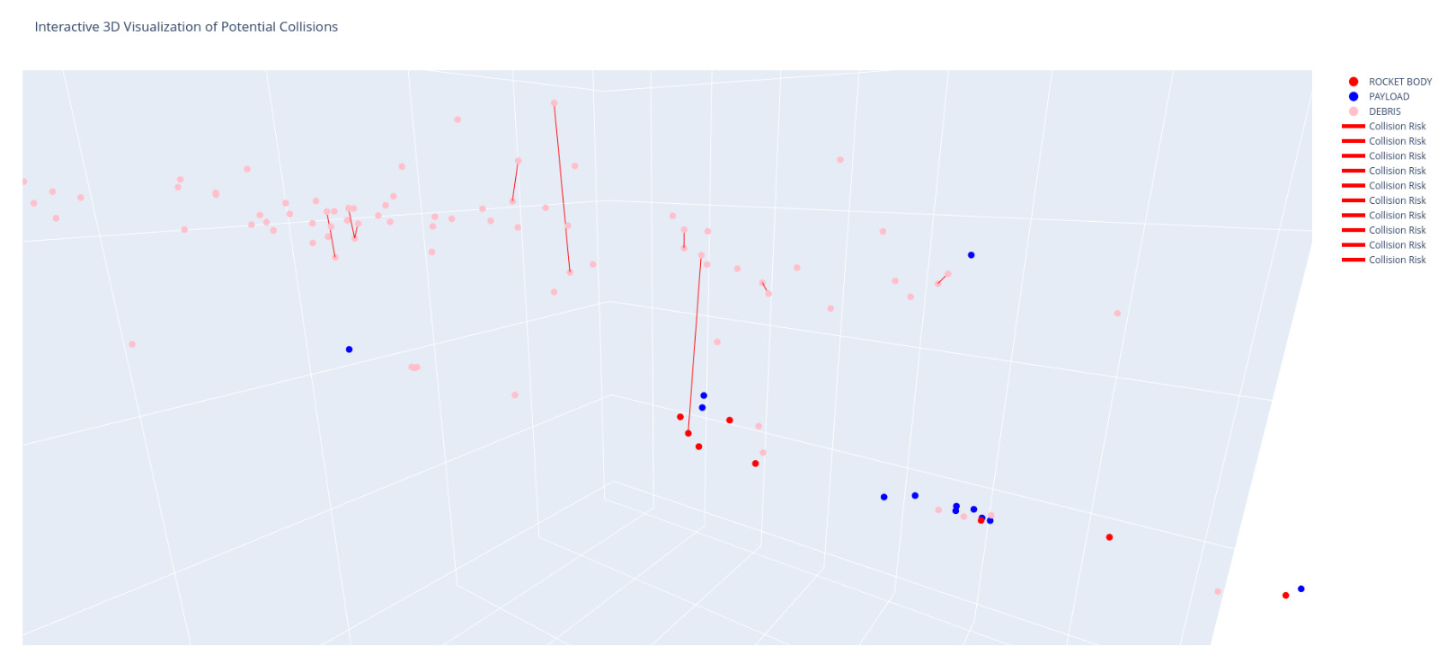


PAGE 06

Slide 15
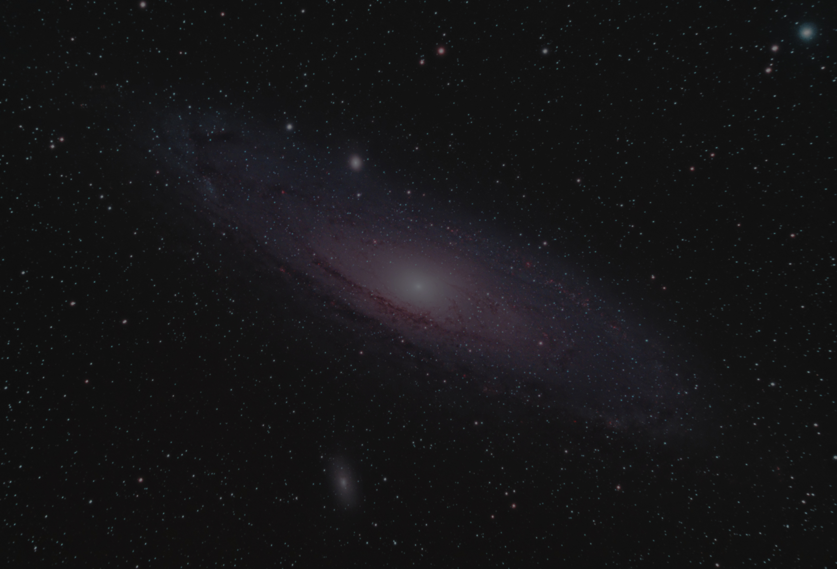
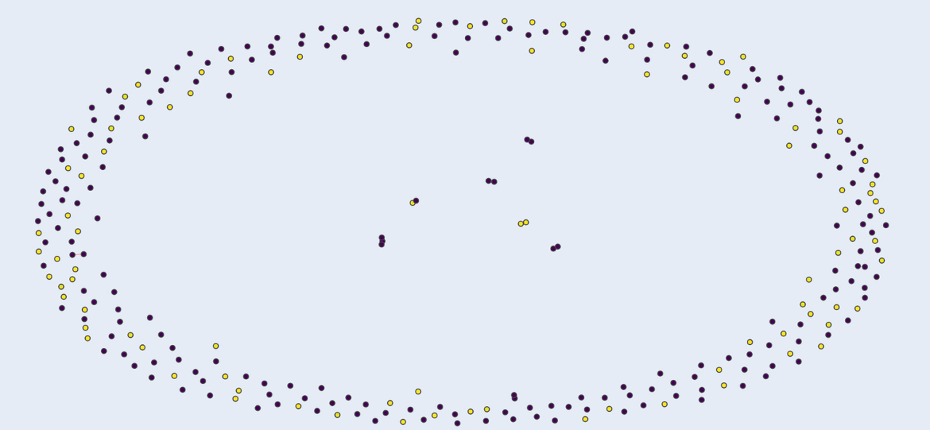
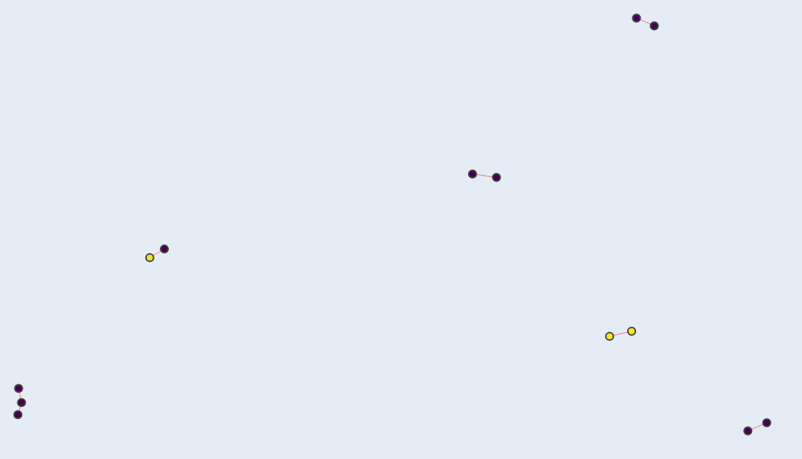
PROJECT PRESENTATION
PAGE 07

Slide 16
FUTURE DIRECTIONS
Improvements for the current project:
Incorporating real-time tracking data for dynamic collision prediction.
Refining models with perturbation effects (e.g., atmospheric drag, solar radiation pressure).
Expanding the scope:
Predicting long-term debris behavior using time-series modeling.
Developing automated collision avoidance algorithms.
PROJECT PRESENTATION
PAGE 08

Slide 17

THANK
YOU
www.reallygreatsite.com

